Slide 1
Space elevator
Samuel Brooks and Juntian Deng

Slide 2
Overview
Title
History
History 2
Implementation
Pro
Cons
Chart
Cons 2
Summary
References

Slide 3
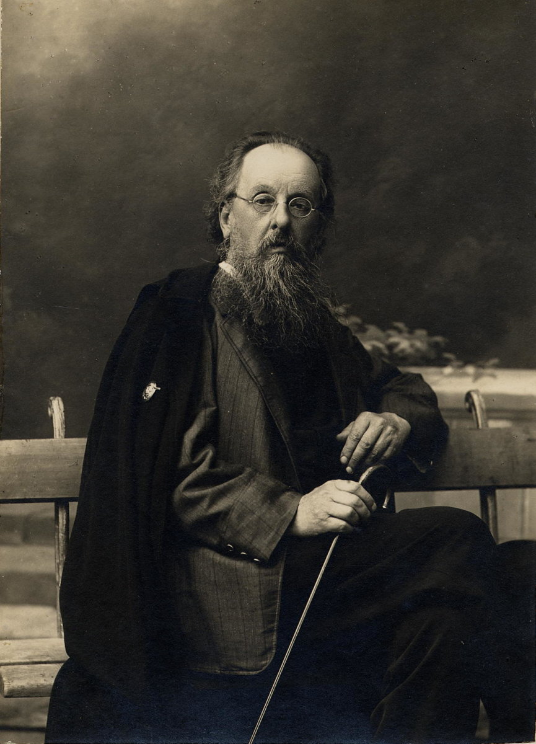
Historic
Conceptualizer - Russian scientist Konstantin Tsiolkovsky
Idea first emerged in 1895
20th century
In 1959, Yuri N. Artsutanov proposes using geostationary satellite, instead of building up, starting from the top and going down using a cable
In 1966, Isaacs, Vine, Bradner, and Bachus research on the strength of a material needed, conclude that no current materials on Earth exist that are strong enough for the ideas that were proposed for the Space elevator
In 1975, Jerome Pearson presented ideas of the Moon presenting dangers to construction, as well as re-inventing the idea of cable cross-sections
In 2000, Bradley C. Edwards presented the idea of using a paper-thin nanotube, and analyzed and presented the dangers of potential problems that could arise, such as ocean hazards, costs, and where the base would be built.
Notes:
The key concept of the space elevator appeared in 1895 when Russian scientist Konstantin Tsiolkovsky was inspired by the Eiffel Tower in Paris. He considered a similar tower that reached all the way into space and was built from the ground up to the altitude of 35,786 kilometers, the height of geostationary orbit.[16] He noted that the top of such a tower would be circling Earth as in a geostationary orbit. Objects would acquire horizontal velocity due to the Earth's rotation as they rode up the tower, and an object released at the tower's top would have enough horizontal velocity to remain there in geostationary orbit. Tsiolkovsky's conceptual tower was a compression structure, while modern concepts call for a tensile structure (or "tether").

Slide 4
Historic (Slide 2)
21st Century
Competitions to provide good ideas for the construction of the elevator would be presented prize money
LiftPort group announces the building of a nanotube factory, hoped to be in the eventual use of the space elevator
Notes:
To speed space elevator development, proponents have organized several competitions, similar to the Ansari X Prize, for relevant technologies.^{[23][24]} Among them are Elevator:2010, which organized annual competitions for climbers, ribbons and power-beaming systems from 2005 to 2009, the Robogames Space Elevator Ribbon Climbing competition,^{[25]} as well as NASA's Centennial Challenges program, which, in March 2005, announced a partnership with the Spaceward Foundation (the operator of Elevator:2010), raising the total value of prizes to US$400,000.^{[26][27]} The first European Space Elevator Challenge (EuSEC) to establish a climber structure took place in August 2011.^{[28]}

Slide 5
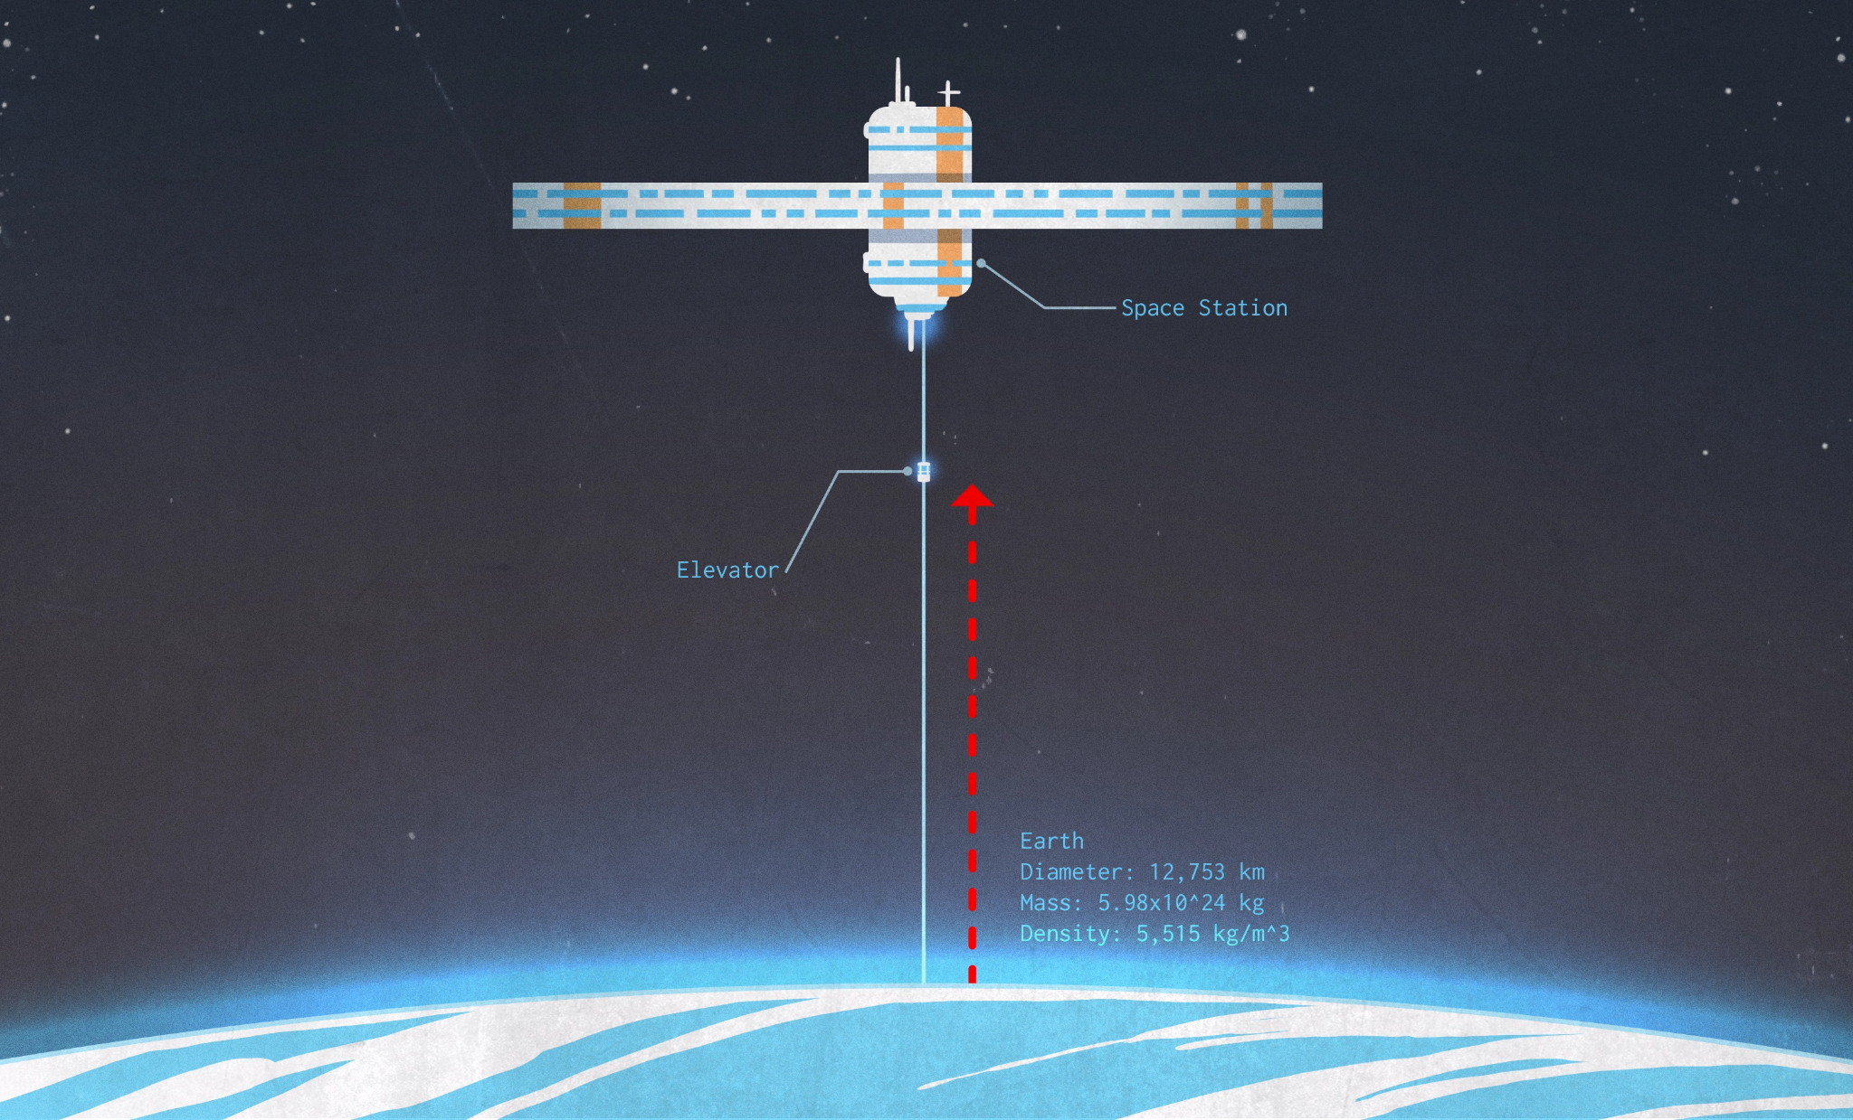
Implementation
Traveling to other planets
It could allow Earth to expand the population to other planets like mars.
Transporting space materials and other cargo at a faster pace
We could mine materials from other planets and bring them back to use on Earth.
Gaining space knowledge
It would allow us to get samples and test them at a faster rate
Notes:
colonists build a space elevator on Mars that allows both for more colonists to arrive and also for natural resources mined there to be able to leave for Earth.For these reasons, Penoyre and Sandford say access to the Lagrange point is major advantage of the spaceline. “The Lagrange point base camp is the thing we believe to be most important and influential for the early use of the spaceline (and for human space exploration in general),” they say.

Slide 6
Pros and Upsides
Revolutionizes human access to space
First country to deploy a space elevator could potentially control nearly all space activity.
Costs reduced for space access, rocket ships may no longer be only option
Notes:
With a space elevator, materials might be sent into orbit at a fraction of the current cost. As of 2000, conventional rocket designs cost about US$25,000 per kilogram (US$11,000 per pound) for transfer to geostationary orbit.^{[73]} Current space elevator proposals envision payload prices starting as low as $220 per kilogram ($100 per pound),^{[74]} similar to the $5–$300/kg estimates of the Launch loop, but higher than the $310/ton to 500 km orbit quoted^{[75]} to Dr. Jerry Pournelle for an orbital airship system.
Philip Ragan, co-author of the book Leaving the Planet by Space Elevator, states that "The first country to deploy a space elevator will have a 95 percent cost advantage and could potentially control all space activities."

Slide 7
Cons
Financial costs
Massive amounts of money would have to be spent on the construction of such a structure, as the materials needed would have to be in massive proportions.
Materials
Large amounts of materials that can help sustain the elevator would be required, which when taken from the environment could cause considerable damage.
If the elevator fails the people on it could die
Notes:
The taper ratio becomes very large unless the specific strength of the material used approaches 48 (MPa)/(kg/m3). Low specific strength materials require very large taper ratios which equates to large (or astronomical) total mass of the cable with associated large or impossible costs.
Corrosion is thought by some to be a risk to any thinly built tether (which most designs call for). In the upper atmosphere, atomic oxygen steadily eats away at most materials.

Slide 8
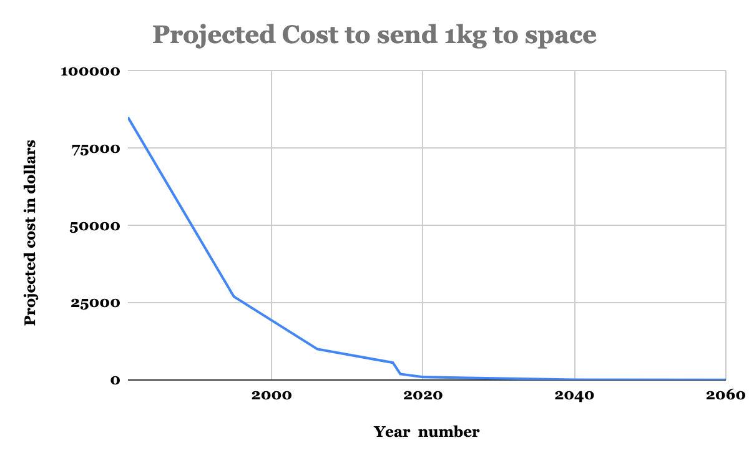
Projected costs of sending items to space
Notes:
Over the years, the amount of money required will go from tens of thousands, to thousands, to hundreds, to tens, and finally to single digits.

Slide 9
Cons (slide 2)
Safety
Forces from space, and faulty building
Construction challenges
External forces from space such as asteroids can damage the structure
Moon gravitational forces and winds can damage structure
Notes:
On these early systems, the time spent moving through the Van Allen radiation belts would be enough that passengers would need to be protected from radiation by shielding, which would add mass to the climber and decrease payload.
Corrosion is thought by some to be a risk to any thinly built tether (which most designs call for). In the upper atmosphere, atomic oxygen steadily eats away at most materials.

Slide 10
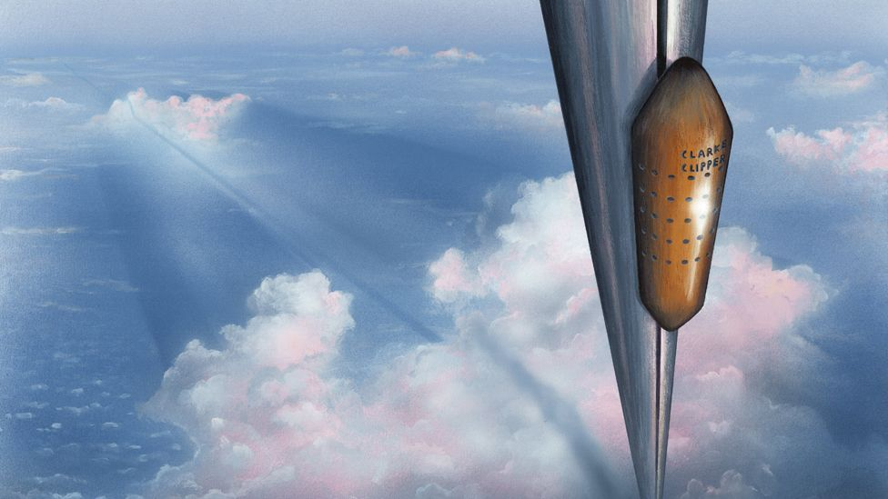
Summary
If we had all the materials to make and work this elevator we would definitely be on board for the advancement of the Space Elevator. It would help make advancements in space exploration and help humans expand population to make more innovations as a society.

Slide 11
References
Konstantin Tsiolkovsky
Space Elevator FAQ
The Audacious Space Elevator
The orbital tower: a spacecraft launcher using the Earth’s rotational energy
How much would it cost to build a space elevator?
Space elevator possible
Pic 1
Pic 2
Pic 3

